Slide 1

WELCOME

Slide 2
SHOPNEX
E-COMMERCE PLATFORM
CREATED BY: MR SARGAR SACHIN SOMNATH
UNDER THE GUIDANCE OF : PROF.C.N. REDDY

Slide 3


INDEX
INTRODUCTION
SCOPE OF SYSTEM OBJECTIVE
PURPOSE OF SYSTEM
FEASIBILITY STUDY
FUNCTIONAL REQUIREMENTS
NON FUNCTIONAL REQUIREMENTS
DIAGRAMS
USER INTERFACE
TABLES
ADVANTAGES AND DISADVANTAGES
PROJECT GOAL
CONCLUSION

Slide 4
INTRODUCTION
Enhanced Shopping Experience: Shopnex offers personalized recommendations, smooth checkout, and multiple payment options for a convenient and enjoyable shopping journey.
Powerful Seller Tools: Sellers benefit from an intuitive dashboard to manage inventory, track sales, and analyze customer behavior, optimizing their business operations.
Secure and Seamless Environment: With real-time tracking and a strong focus on data privacy, Shopnex ensures a safe and efficient platform for both buyers and sellers.

Slide 5

SCOPE OF SYSTEM
Enhancing Customer Experience: Provide a user-friendly interface, AI-driven recommendations, and secure, streamlined checkout options.
Empowering Local Businesses: Enable SMBs to set up online stores easily with minimal technical barriers.
Ensuring Security and Trust: Implement robust encryption, ensure data privacy, and comply with legal standards for secure transactions.

Slide 6

PURPOSE OF SYSTEM
AND OBJECTIVE
User Experience: Deliver an intuitive interface and AI-driven personalization to enhance the shopping experience with tailored recommendations and deals.
Seller Tools: Provide robust inventory management, marketing tools, and a dashboard with analytics to empower sellers and help them grow their businesses.
Payments: Offer multiple secure payment options, including cards, UPI, and cash-on-delivery.
Logistics: Ensure reliable delivery services with real-time updates and efficient returns for timely order fulfillment.

Slide 7
FEASIBILITY STUDY
The feasibility study will evaluate Shopnex’s viability in terms of technical, operational, market, and financial aspects.
Technical Feasibility: Review system requirements, scalability, and technology stack.
Operational Feasibility: Examine workflows, resource needs, and risk management.
Financial Feasibility: Assess revenue models, costs, and
financial projections.

Slide 8
FUNCTIONAL REQUIREMENTS
1. User Registration: Secure registration and login.
2. Product Management: Add, edit, and delete product listings.
3. Shopping Cart: Add items and complete purchases with multiple payment options.
4. Order Management: Track orders and manage sales.
5. Customer Support: Helpdesk and live chat assistance.
6. Reviews: User reviews with moderation.
7. Logistics Integration: Delivery tracking.

Slide 9
NON FUNCTIONAL REQUIREMENTS
1. Performance: Load within
3 seconds: handle 10,000 concurrent users.
2. Scalability: Support horizontal scaling.
3. Security: Data encryption and privacy compliance.
4. Usability: Intuitive user interface.
5. Availability: 99.9% uptime.
6. Maintainability: Modular code and documentation.
7. Compatibility: Accessible on all devices and browsers.

Slide 10
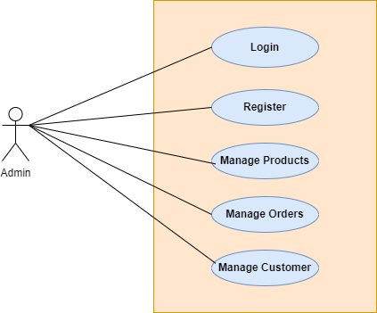
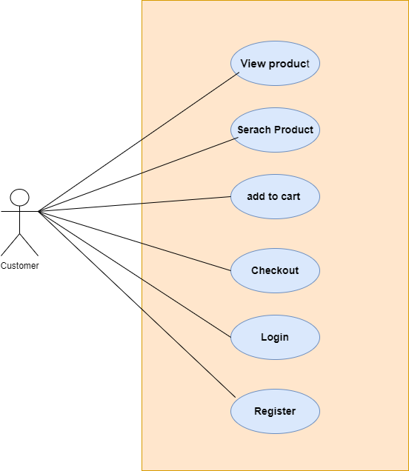
DIAGRAMS
Use Case Diagram

Slide 11

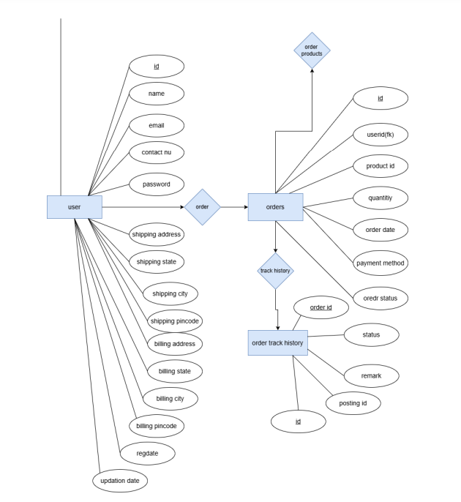
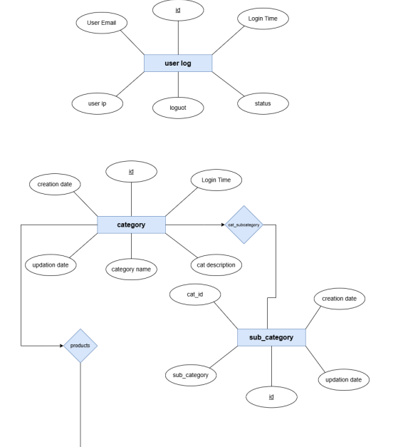
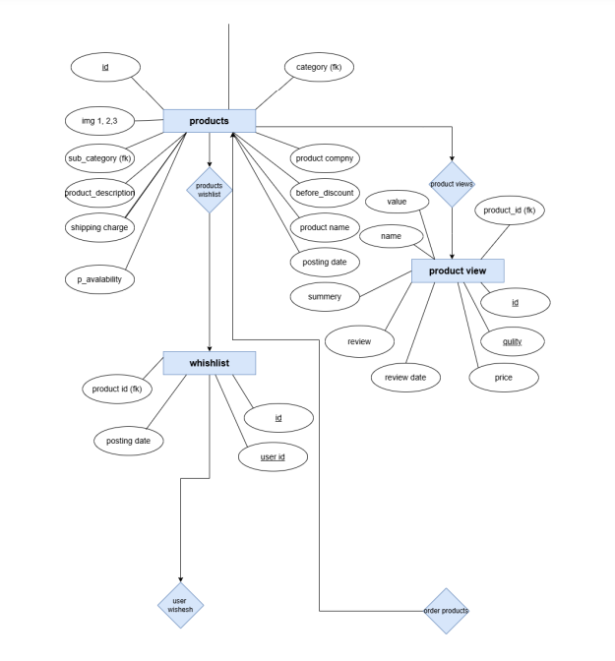
ER Diagrams
1
3
2

Slide 12
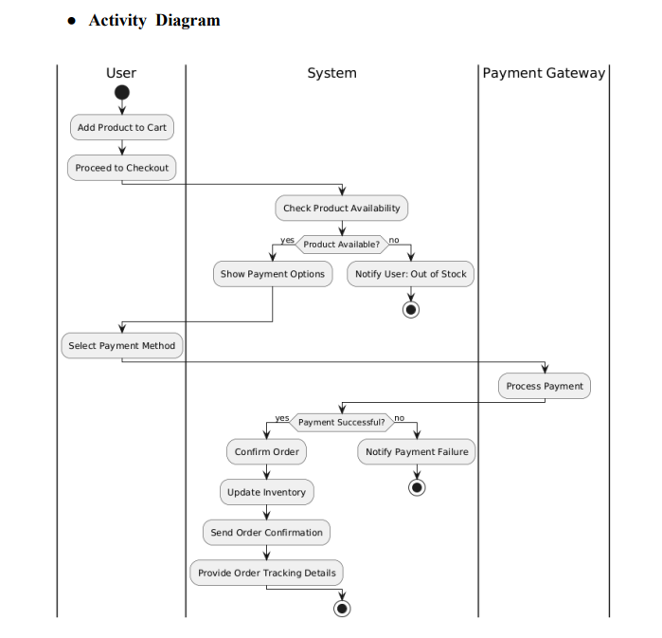
Class Diagram

Slide 13
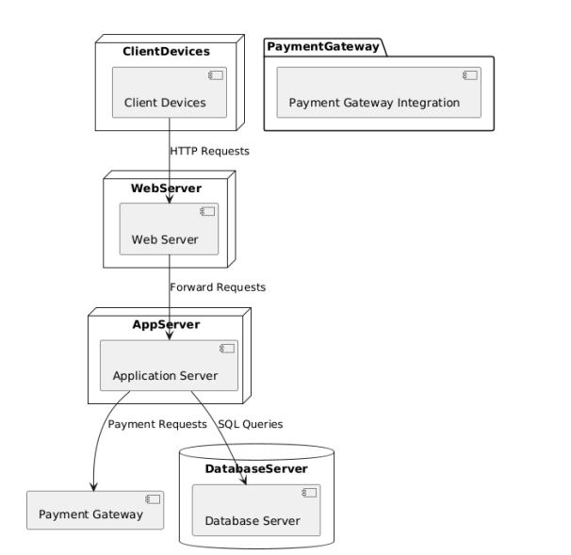
Depoloy ment diagram

Slide 14
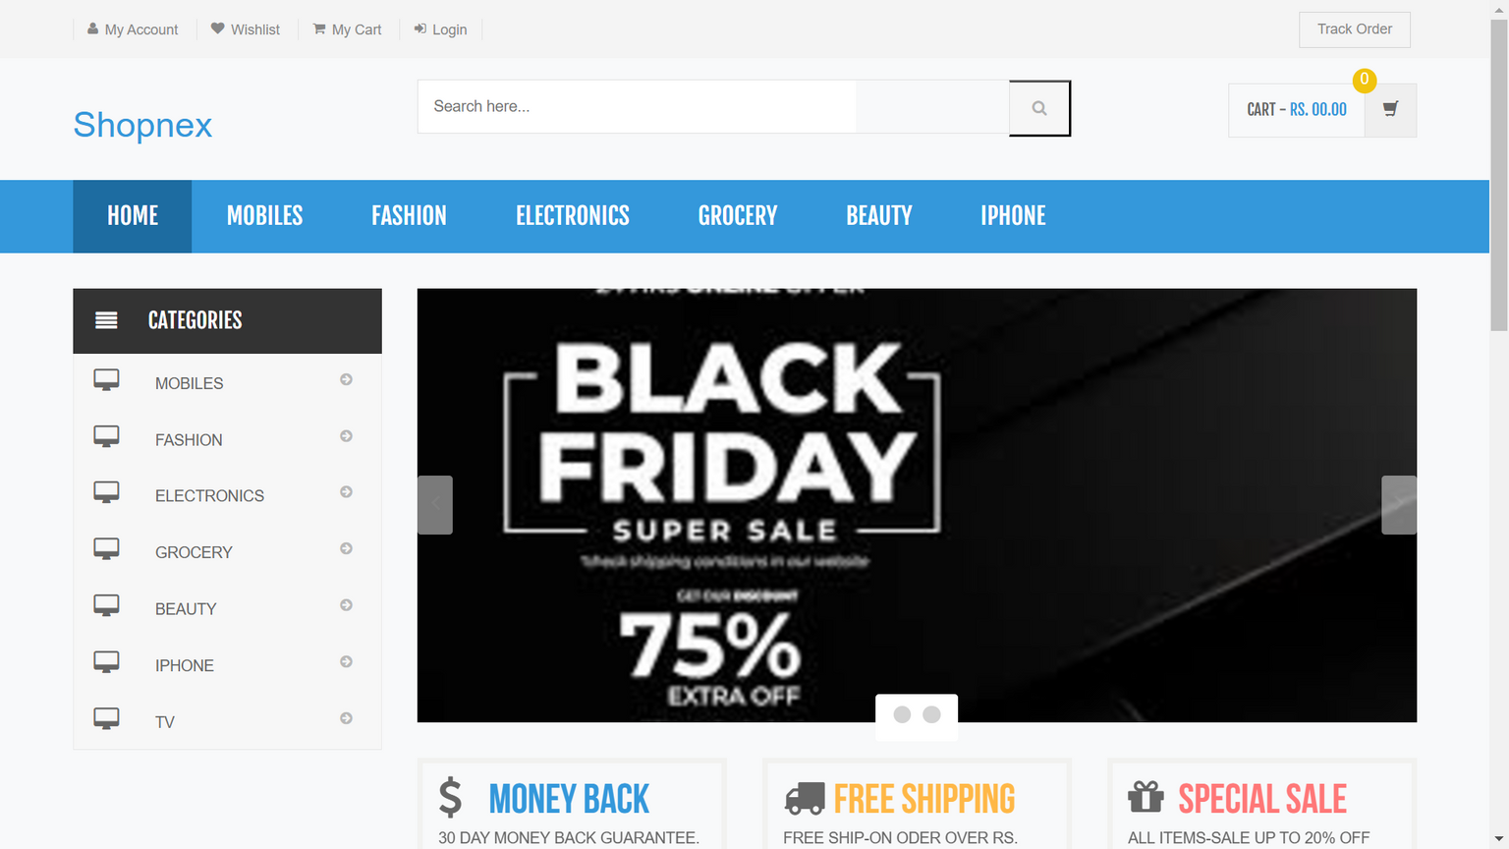
USER INTERFACE

Slide 15
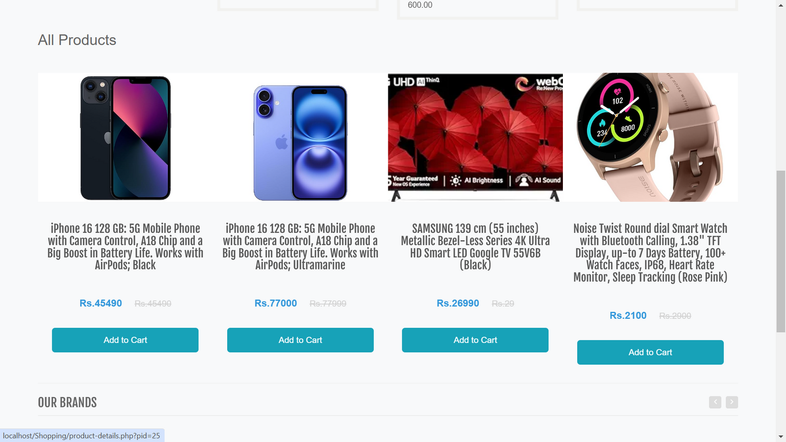
USER INTERFACE

Slide 16
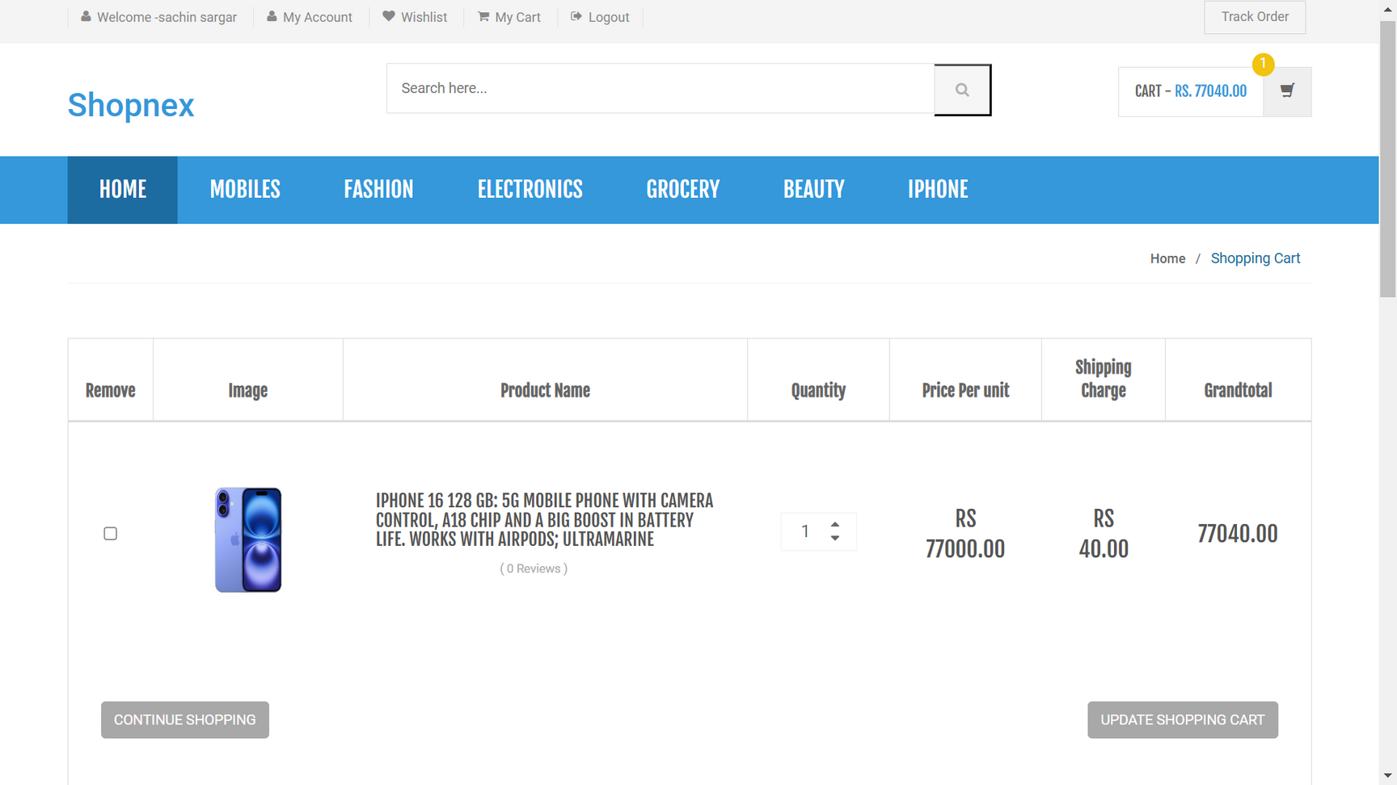
USER INTERFACE

Slide 17
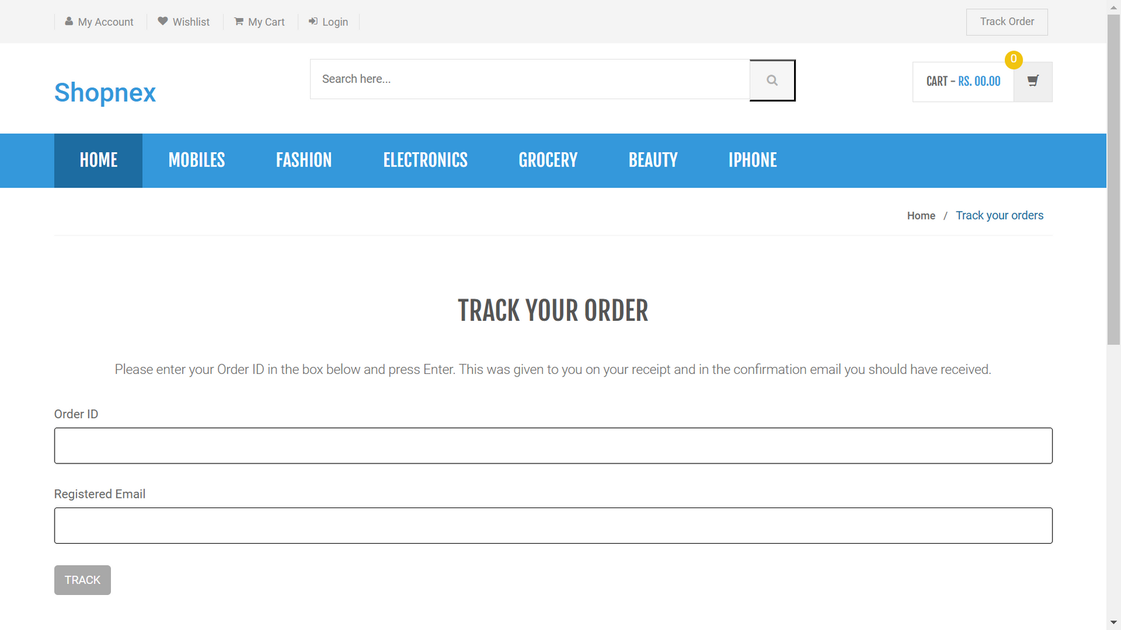
USER INTERFACE

Slide 18
USER INTERFACE

Slide 19
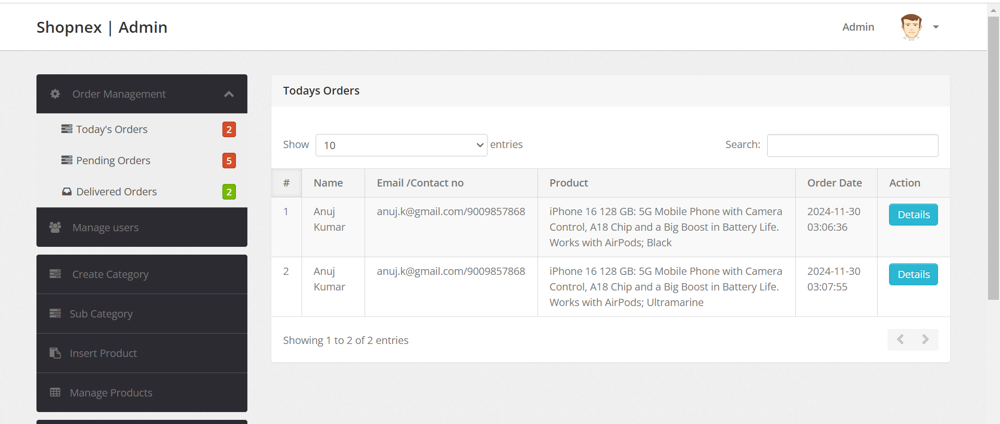
USER INTERFACE

Slide 20
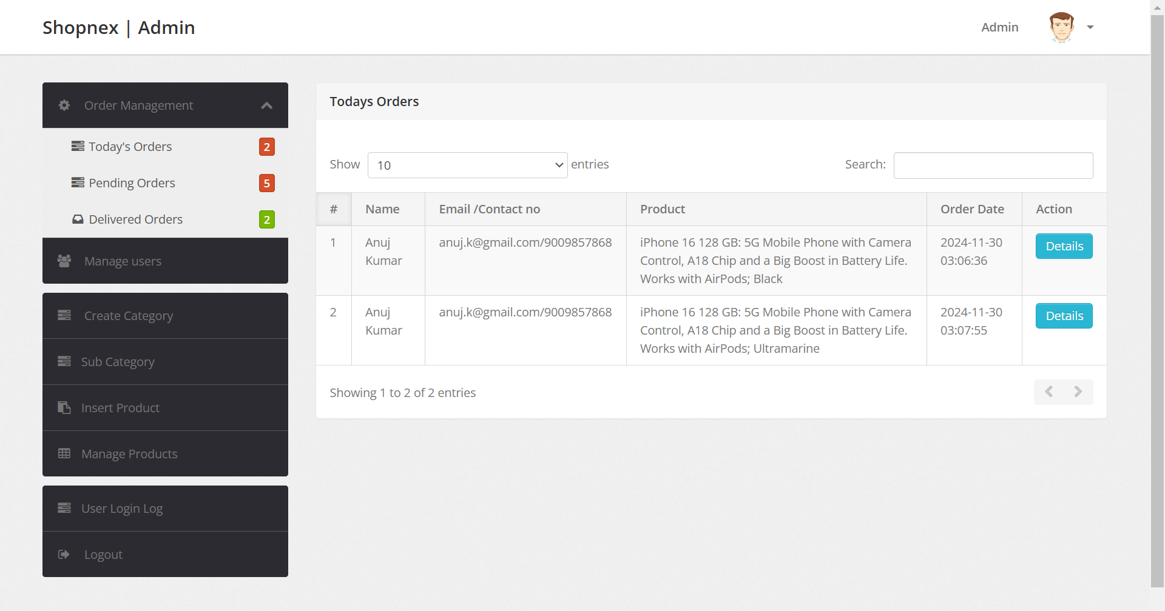
USER INTERFACE

Slide 21
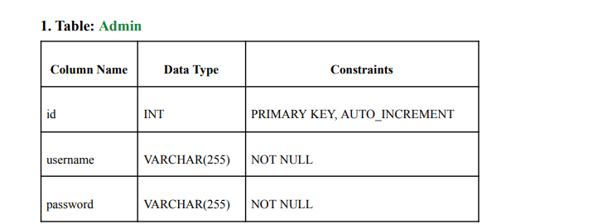
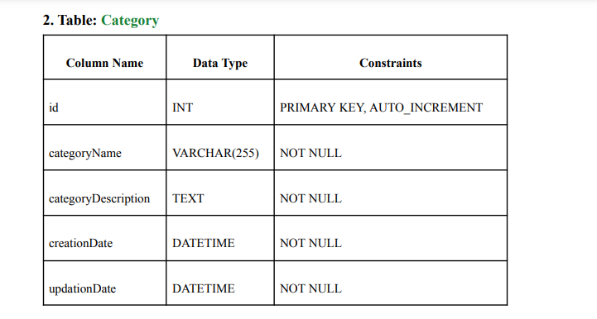
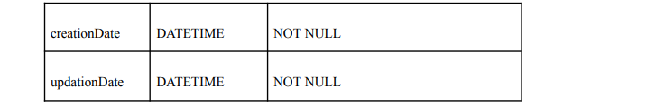
TABLE STRUCTURE

Slide 22
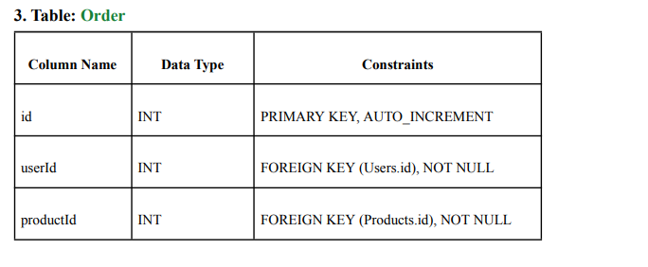
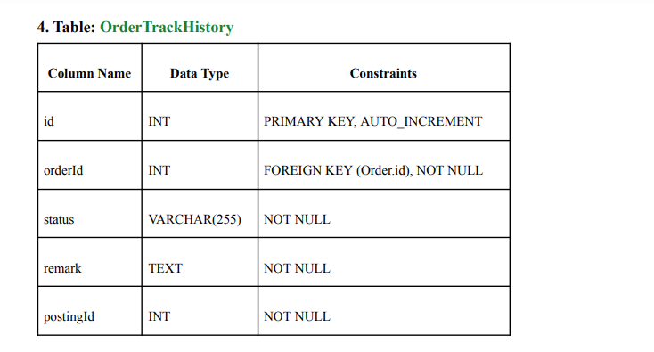
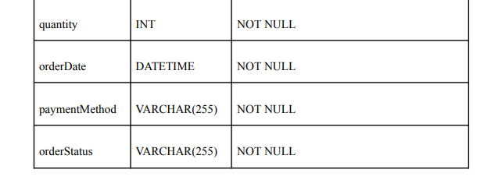
TABLE STRUCTURE

Slide 23
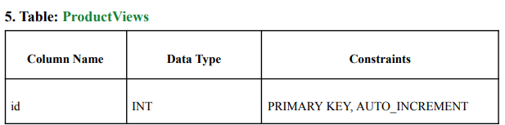
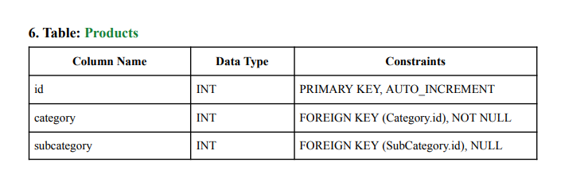
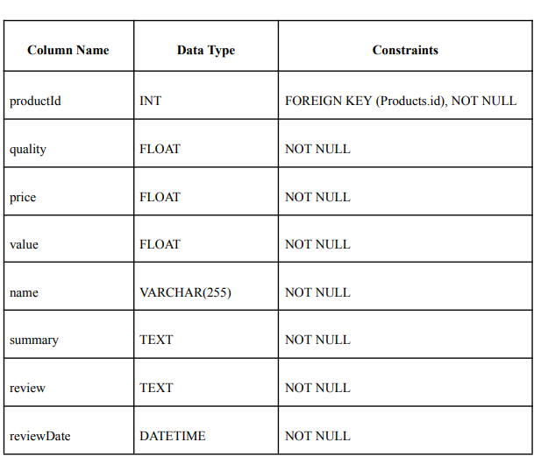
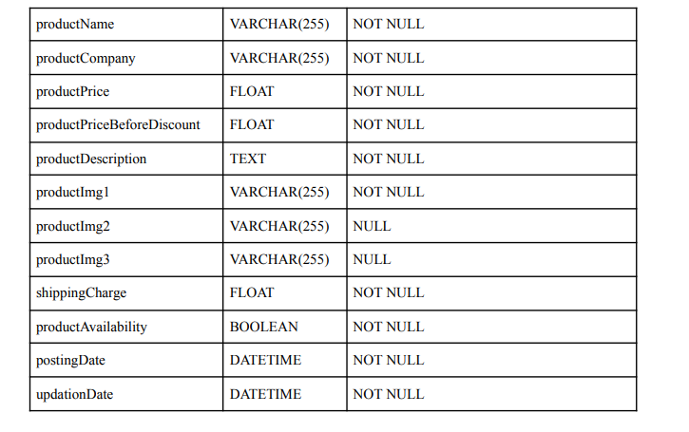
TABLE STRUCTURE

Slide 24
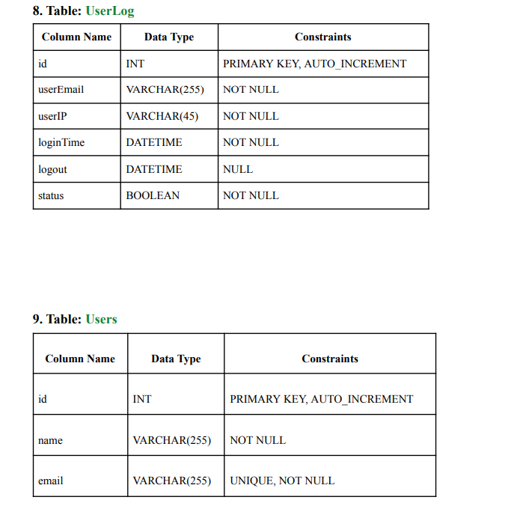
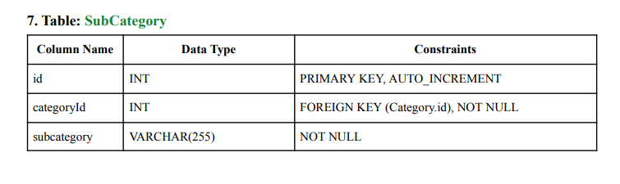
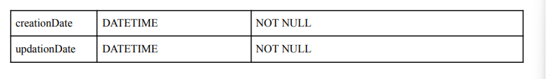
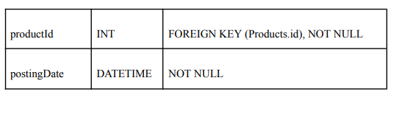
TABLE STRUCTURE

Slide 25

ADVANTAGES
01
Personalized Shopping Experience: AI-driven recommendations and tailored deals improve user engagement and satisfaction.
02
Empowered Sellers: The platform offers robust tools for inventory management, marketing, and sales analytics, helping sellers grow their businesses.

Slide 26
DISADVANTAGES
01
Technical Complexity: Integrating AI and managing real-time analytics can be complex and costly.
02
Market Competition: The platform faces high competition from established players in the Indian e-commerce market.

Slide 27
PROJECT GOALS
01
Improve Online Shopping
Create a smooth, personalized shopping experience with secure payment options.
02
Goal: Ensure strong security and trust by using robust encryption and complying with legal standards for data privacy, payments, and consumer rights.

Slide 28
CONCLUSION
ShopNex offers a robust, feature-rich e-commerce platform that provides an intuitive and seamless shopping experience. It combines secure payment gateways, inventory management, and personalized recommendations, while supporting business operations and ensuring scalability for future growth. The platform emphasizes security and responsive design for optimal performance across devices.

Slide 29
THANK YOU

